Slide 1
PGVCL Training
Day-1

Slide 2
Flutter Training for PGVCL Department
Day 1: Introduction to Flutter and Widget Tree

Slide 3
Overview
Topics We’ll Be Covering For Today
Practical & Assignment
Build a simple app with Stateless and Stateful Widgets (e.g., Counter App).
Assignment:
Create a basic UI with 3 Stateless Widgets and 2 Stateful Widgets.
Theory
Introduction to Flutter.
Understanding the Widget Tree: Stateless and Stateful Widgets.
Basic Flutter App Structure

Slide 4
What is Flutter?
Flutter is an open-source UI toolkit by Google.
It allows building compile natively apps for mobile, web, and desktop from a single codebase.
Uses Dart programming language for fast and efficient development.
Hot Reload feature enables faster development cycles.

Slide 5
Flutter is an open-source framework from Google that allows developers to build apps for multiple platforms using a single codebase
Platforms: Flutter supports apps for iOS, Android, the web, Windows, MacOS, and Linux
Features: Flutter includes tools for automated testing, developer tooling, and more

Slide 6
Compilation: Flutter code compiles to ARM or Intel machine code, as well as JavaScript
Rendering engine: Flutter ships apps with its own rendering engine, which outputs pixel data directly to the screen
Widgets: Flutter includes a collection of UI building blocks, or widgets, like tabs, dropdowns, and buttons

Slide 7
Flutter was first described in 2015 and released in May 2017. It's used by developers and organizations around the world, including Google for apps like Google Pay and Google Earth.

Slide 8
What is State?
The State is the information that can be read synchronously when the widget is built and might change during the lifetime of the widget.
Two Types of Widgets are there
Stateful Widgets
Stateless Widgets

Slide 9
Understanding the Widget Tree:
Stateful and Stateless Widgets
The widget tree represents the static structure of your UI, while the element tree is responsible for managing the state of the widgets that make up the UI. By understanding these concepts, you can create efficient and effective Flutter applications that provide a smooth and engaging user experience.

Slide 10
Understanding the Widget Tree:
Stateful and Stateless Widgets
Stateful widgets
Can change their state over time, based on user interactions or data received. They are dynamic and can update their appearance. Examples include checkboxes, radio buttons, sliders, forms, and text fields.

Slide 11
Understanding the Widget Tree:
Stateful and Stateless Widgets
Stateless widgets
Cannot change their state after they've been created. They are static and represent an immutable UI element. Examples include icons, IconButton, and Text.

Slide 12
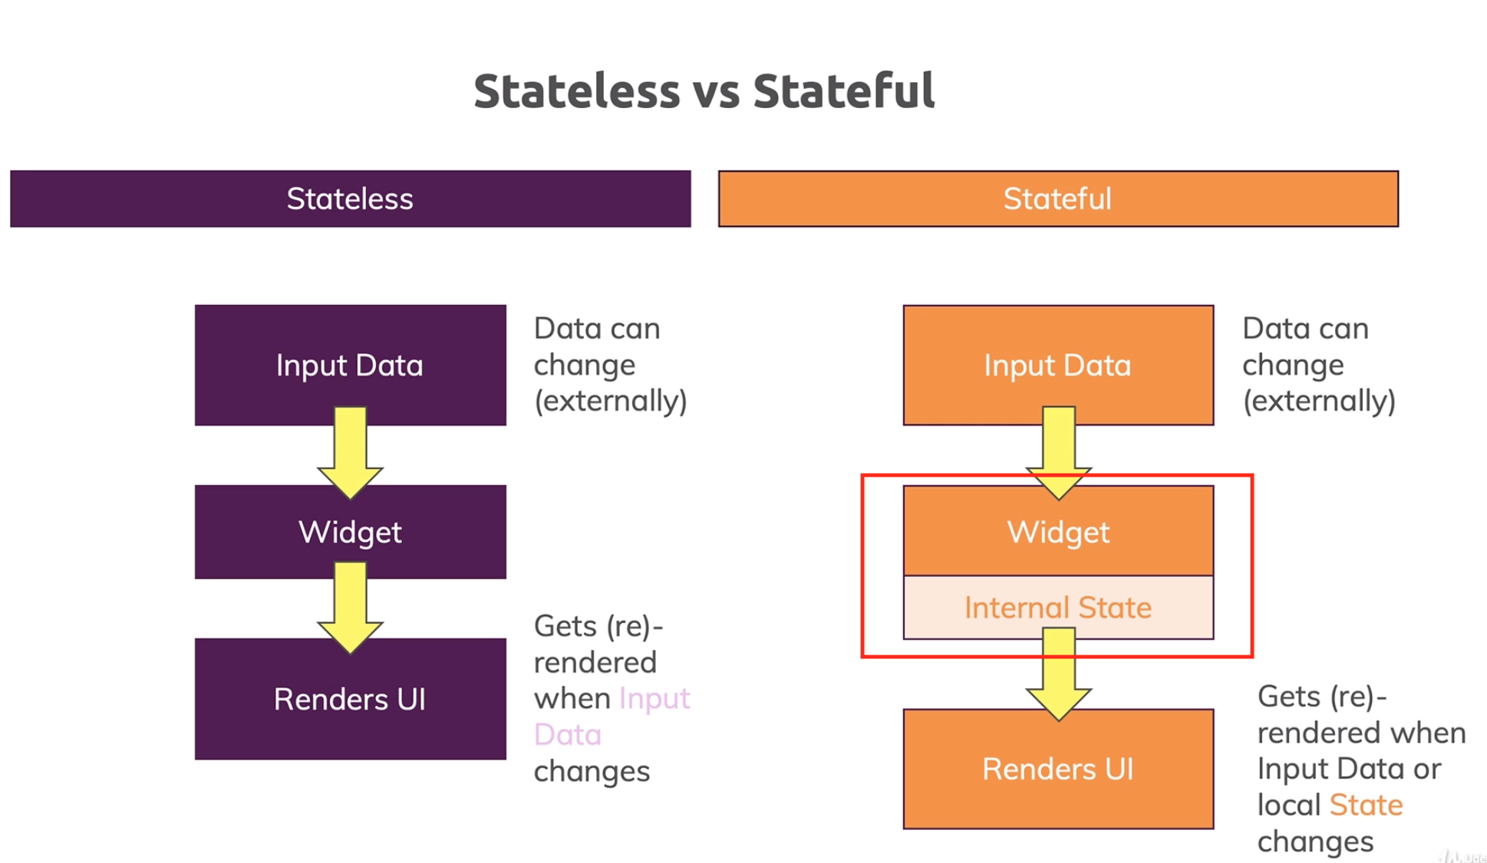

Slide 13
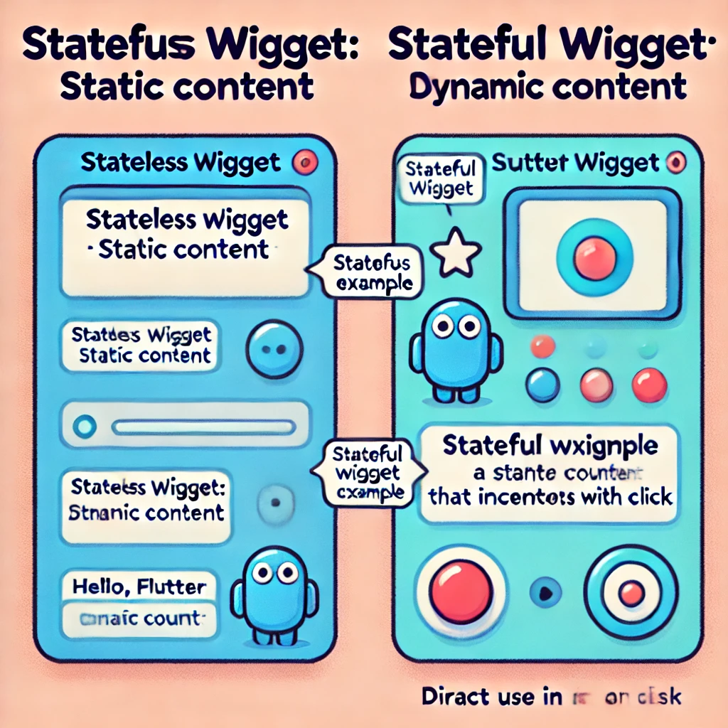

Slide 14
Basic Flutter App Structure
Your Flutter application should split into two broad layers, the UI layer and the Data layer. Each layer is further split into different components, each of which has distinct responsibilities, a well-defined interface, boundaries and dependencies.

Slide 15
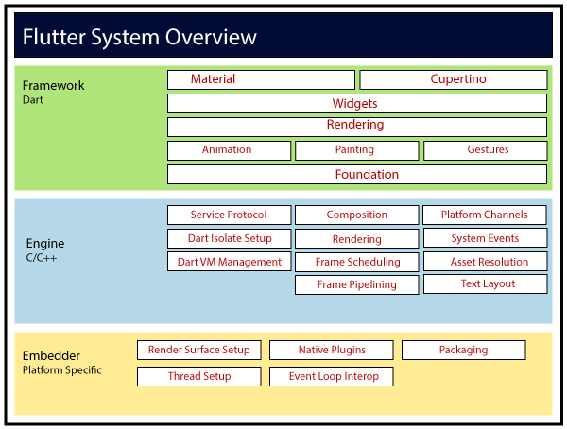

Slide 16
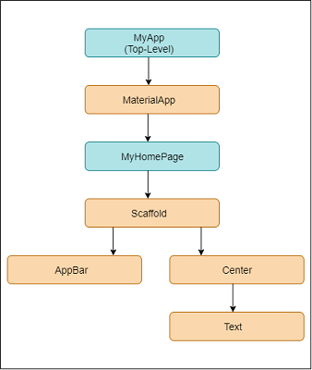

Slide 17
Flutter – Architecture Application
Flutter architecture application mainly consists of:
Widgets
Gestures
Concept of State
Layers

Slide 18
Widgtes
Widgets are the primary component of any flutter application. It acts as a UI for the user to interact with the application. Any flutter application is itself a widget that is made up of a combination of widgets.

Slide 19
Layers
The Flutter framework is categorized based on its complexity and establishes a hierarchy based on the decreasing level of these complexities. These categories are often called Layers.

Slide 20
Gestures
All physical form of interaction with a flutter application is done through pre-defined gestures. Gesture-Detectors are used for the same. It is an invisible widget that is used to process physical interaction with the flutter application. The interaction includes gestures like tapping, dragging, and swiping, etc.

Slide 21
Concept of State
The architecture of a Flutter app or the flutter framework generally consists of a combination of small and larger widgets interacting in conjunction to build the application. All of its layers are integral to its design and functioning. As simple as building an application in flutter is, it is built with equally complex components at its core.

Slide 22
Practical Example
https://github.com/prakruti95/PGVCL_Training/tree/main/Day1/crpt_stateful_counter
https://github.com/prakruti95/PGVCL_Training/tree/main/Day1/crpt_stateless_counter
Assignment Example
Create a basic UI with 3 Stateless Widgets and 2 Stateful Widgets

